Slide 1

STATISTICAL ANALYSIS OF MATERNAL HEALTH RISK
PROJECT PRESENTATION SESSION 2021-2022
SUBMITTED TO
RASHTRASANT TUKDOJI MAHARAJ NAGPUR UNIVERSITY, NAGPUR
SUBMITTED BY
Ms. VAISHNAVI P. WAGHMARE Ms. DURGA C.HINGWE Ms. HITESHREE GOSWAMI
GUIDED BY
Ms. MUKTA DESHPANDE MAM
POST GRADUATION TEACHING DEPARTMENT OF STATISTICS, RTMNU, NAGPUR.

Slide 2
CONTENTS
1.Introduction
2.FACTOR AFFECTING ON MATERNAL HEALTH
a)Age
b) Blood pressure
c) Blood glucose level
d) Heart rate
3.COLLECTION OF DATA
4.DATA ANALYSIS
5.CONCLUSION
6.REFERENCES

Slide 3

STUDY OF MATERNAL HEALTH RISK

Slide 4
Introduction
Maternal health has been becoming a global concern because the lives of millions of women of reproductive age can be saved through maternal health care services.
Women who remain healthy during pregnancy and after birth are more likely to stay healthy later in life and have better birth outcomes, childhood and adulthood.
Therefore, the health and well-being of women matter to every person, society, and country and are essential for the achievement of the Sustainable Development Goals.
Many pregnant women die from pregnancy issues as a result of a lack of information on maternal health care during and after pregnancy. It is more common in rural regions and among lower–middle–class families in emerging countries. During pregnancy, every minute should be observed to ensure the proper growth of the baby and the safe delivery.

Slide 5
FACTORS AFFECTING PREGNANCY COMPLICATIONS
Pregnancy Complication
Complications of pregnancy are health problems that occur during pregnancy. They can involve the mother’s health, the baby’s health, or both.
Some women have health problems that arise during pregnancy, and other women have health problems before they become pregnant that could lead to complications.
Women need to receive health care before and during pregnancy to decrease the risk of pregnancy complications.

Slide 6
Effect of different factors on maternal health.
A study on menstruation of Indian adolescent girls
In our data women of age 10 to 70 is covered in it. In a cross-sectional study, which was conducted on 536 healthy menstruating females aged 10–19 years.
Standardized self-reporting questionnaires were used to obtain relevant data. The result come as Mean age of menarche was 13 ± 1.1 years with wide variations, i.e., 10–17 years.

Slide 7
AGE
Maternal age affects pregnancy from conception to delivery. Medical diseases, such as Diabetes Mellitus and hypertension which occur with the increasing age, add to the age-related risks of pregnancy.
Fertility declines with age and the risk of miscarriages, ectopic pregnancies, chromosomal abnormalities. The latter half of pregnancy may be complicated by gestational diabetes mellitus (GDM), intrauterine growth restriction (IUGR), and antepartum hemorrhage.
There is a higher incidence of instrumental deliveries, Cesarean section, and postpartum hemorrhage among these women.
Studies have been conducted On given data to analyze the effects of advanced and starting maternal age on pregnancy outcome.
As the number of women with advanced maternal age has also been increasing in developing countries like ours, we conducted a prospective observational study to evaluate the pregnancy outcomes in women aged 35 years and above.

Slide 8
BLOOD PRESSURE
Blood pressure is the force of your blood as it pushes against artery walls while your heart pumps. It can go up or down at certain times of the day, and it may change if you’re feeling excited or nervous.
There are 2 types of Blood pressure consider such as SystolicBP And DystolicBP
SystolicBP
High blood pressure during pregnancy poses various risks, including: Decreased blood flow to the placenta. If the placenta doesn't get enough blood, your baby might receive less oxygen and fewer nutrients. This can lead to slow growth (intrauterine growth restriction), low birth weight or premature birth.
DystolicBP
Low blood pressure could reduce the rate at which the fetus receives a continuous supply of blood. Low blood pressure in pregnant women could cause brain damage to the fetus and could also result in stillbirth in a few cases.

Slide 9
The American College of Obstetricians and Gynecologists (ACOG) state that a pregnant woman's blood pressure should also be within the healthy range of less than 120/80 mm Hg. If blood pressure readings are higher, a pregnant woman may have elevated or high blood pressure.
BLOOD GLUCOSE LEVEL
High blood sugar can cause problems all over the body. It can damage blood vessels and nerves. It can harm the eyes, kidneys, and heart. In early pregnancy, high blood sugar can lead to birth defects in a growing baby.
High blood glucose levels during pregnancy can also increase the chance that your baby will be born too early, weigh too much, or

Slide 10
have breathing problems or low blood glucose right after birth. High blood glucose also can increase the chance that you will have a miscarriage link or a stillborn baby.
At least 5% of pregnant women develop diabetes during pregnancy. This disorder is called gestational diabetes. Gestational diabetes is more common among the following:
Obese women
Women with a family history of diabetes.
Unrecognized and untreated, gestational diabetes can increase the risk of health

Slide 11
problems for pregnant women and the fetus and the risk of death for the fetus.
So the standard value of blood glucose level in pregnant women should be below 140 mg/dL (7.8 mmol/L ) is considered standard. A blood sugar level of 140 mg/dL (7.8 mmol/L ) to less than 190 mg/dL (10.6 mmol/L ) indicates the need for a three-hour glucose tolerance test to diagnose gestational diabetes.
HEART RATE
During pregnancy, the amount of blood pumped by the heart (cardiac output) increases by 30 to 50%. As cardiac output increases, the heart rate at rest speeds up from a normal prepregnancy rate of about 70 beats per minute to as high as 90 beats per minute.

Slide 12
OBJECTIVE OF THE STUDY
The aim of this study is to evaluate the interrelationship between variables and the factors analysis for predicting the health risk of pregnant women by creating a model.
To predict the maternal health risk of women, if we know the factors like age, blood pressure, blood glucose level, heart rate, and body temperature.
To know the best health condition which are the strongest indications for health risks during pregnancy.

Slide 13
DATA COLLECTION
The current prospective study is carried out on the data which has been taken from https://www.kaggle.com/datasets which was collected from different hospitals, community clinics, and maternal health care through the IoT bases risk monitoring system. Currently, Data contains 454 women with their age, systolic BP, diastolic BP, blood glucose level, heart rate, body temperature, and their respective risk levels. The risk is quantified into low, medium, and high.
In this data, we use age, systolic blood pressure, diastolic blood pressure, blood glucose levels, heart rate, and body temperature to classify the patients with a low, medium, or high risk of having pregnancy complications.

Slide 14
Age | SystolicBP | DiastolicBP | BS | HeartRate | numerical repre | risk level | BodyTemp
25 | 130 | 80 | 15 | 86 | 1 | high risk | 98
35 | 140 | 90 | 13 | 70 | 1 | high risk | 98
29 | 90 | 70 | 8 | 80 | 1 | high risk | 100
30 | 140 | 85 | 7 | 70 | 1 | high risk | 98
35 | 120 | 60 | 6.1 | 76 | 0 | low risk | 98
23 | 140 | 80 | 7.01 | 70 | 1 | high risk | 98
23 | 130 | 70 | 7.01 | 78 | 0.5 | mid risk | 98
35 | 85 | 60 | 11 | 86 | 1 | high risk | 102
32 | 120 | 90 | 6.9 | 70 | 0.5 | mid risk | 98
42 | 130 | 80 | 18 | 70 | 1 | high risk | 98
23 | 90 | 60 | 7.01 | 76 | 0 | low risk | 98
19 | 120 | 80 | 7 | 70 | 0.5 | mid risk | 98
25 | 110 | 89 | 7.01 | 77 | 0 | low risk | 98
20 | 120 | 75 | 7.01 | 70 | 0.5 | mid risk | 100
48 | 120 | 80 | 11 | 88 | 0.5 | mid risk | 98
15 | 120 | 80 | 7.01 | 70 | 0 | low risk | 98
50 | 140 | 90 | 15 | 90 | 1 | high risk | 98
25 | 140 | 100 | 7.01 | 80 | 1 | high risk | 98
30 | 120 | 80 | 6.9 | 76 | 0.5 | mid risk | 101
10 | 70 | 50 | 6.9 | 70 | 0 | low risk | 98
40 | 140 | 100 | 18 | 90 | 1 | high risk | 98
50 | 140 | 80 | 6.7 | 70 | 0.5 | mid risk | 98
21 | 90 | 65 | 7.5 | 76 | 0 | low risk | 98
18 | 90 | 60 | 7.5 | 70 | 0 | low risk | 98
21 | 120 | 80 | 7.5 | 76 | 0 | low risk | 98
16 | 100 | 70 | 7.2 | 80 | 0 | low risk | 98
19 | 120 | 75 | 7.2 | 66 | 0 | low risk | 98
15 | 100 | 49 | 6.8 | 77 | 0 | low risk | 99
15 | 100 | 49 | 6 | 77 | 0 | low risk | 99
12 | 100 | 50 | 6.4 | 70 | 0.5 | mid risk | 98
15 | 100 | 60 | 6 | 80 | 0 | low risk | 98
15 | 100 | 49 | 7.6 | 77 | 0 | low risk | 98
12 | 100 | 50 | 6 | 70 | 0.5 | mid risk | 98
21 | 100 | 50 | 6.8 | 60 | 0 | low risk | 98

Slide 15
DATA ANALYSIS
The data is summarized, clean, and then analyzed. The Analysis of data is done by using some statistical tools and technical tools like MS-EXCEL and SPSS. The following Statistical tools are used for data analysis,
1). Regression.
2). Descriptive Statistics
3). Correlation
4). Principle Component Analysis.

Slide 16
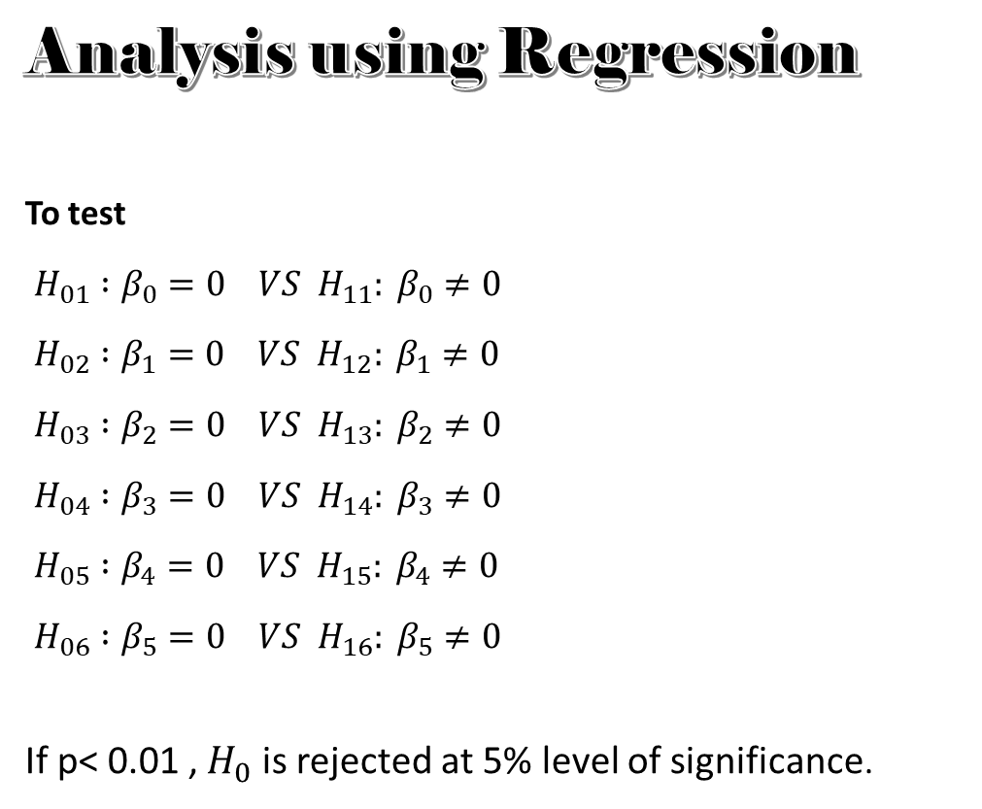
Analysis using Regression
To test
$$H_{01} :β_{0}=0 VS H_{11}: β_{0}≠0$$
$$H_{02} :β_{1}=0 VS H_{12}: β_{1}≠0$$
$$H_{03} :β_{2}=0 VS H_{13}: β_{2}≠0$$
$$H_{04} :β_{3}=0 VS H_{14}: β_{3}≠0$$
$$H_{05} :β_{4}=0 VS H_{15}: β_{4}≠0$$
$$H_{06} :β_{5}=0 VS H_{16}: β_{5}≠0$$
If p< 0.01 , $H_{0}$ is rejected at 5% level of significance.

Slide 17

SUMMARY OUTPUT
Regression Statistics
Multiple R | 0.58526
R Square | 0.34253
Adjusted R Square | 0.335159
Standard Error | 0.339674
Observations | 452
$R^{2}$=0.34256
ANOVA
 | df | SS | MS | F | Significance F
Regression | 5 | 26.80901 | 5.361801101 | 46 | 1.24873E-38
Residual | 446 | 51.45869 | 0.115378237
Total | 451 | 78.2677
Therefore FCal= 1.24873E-38
FCal is Highly significant.

Slide 18
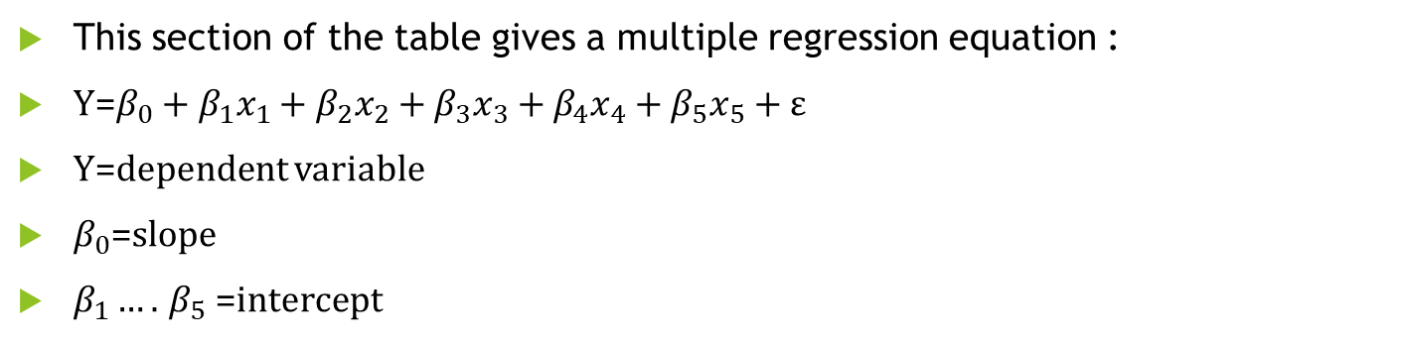
This section of the table gives a multiple regression equation :
Y=$β_{0}+β_{1}x_{1}+β_{2}x_{2}+β_{3}x_{3}+β_{4}x_{4}+β_{5}x_{5}+ε$
Y=dependent variable
$β_{0}$=slope
$β_{1}….$ $β_{5}$ =intercept

Slide 19
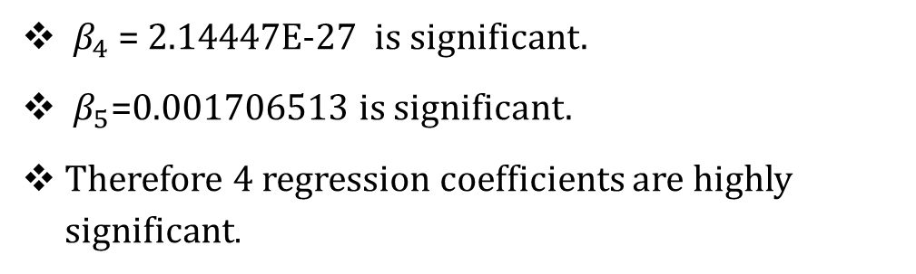

From the above table, the result is
Out of 6 Values 4 are significant.
As those 4 have p< 0.01 as follows:
$β_{0}$= 1.19868E-09 Is significant.
$β_{1}$ = 0.056709249 is insignificant.
$β_{2}$ =0.001169274 is significant.
$β_{3}$=0.622183771 is insignificant.
$β_{4}$ = 2.14447E-27 is significant.
$β_{5}$=0.001706513 is significant.
Therefore 4 regression coefficients are highly significant.

Slide 20
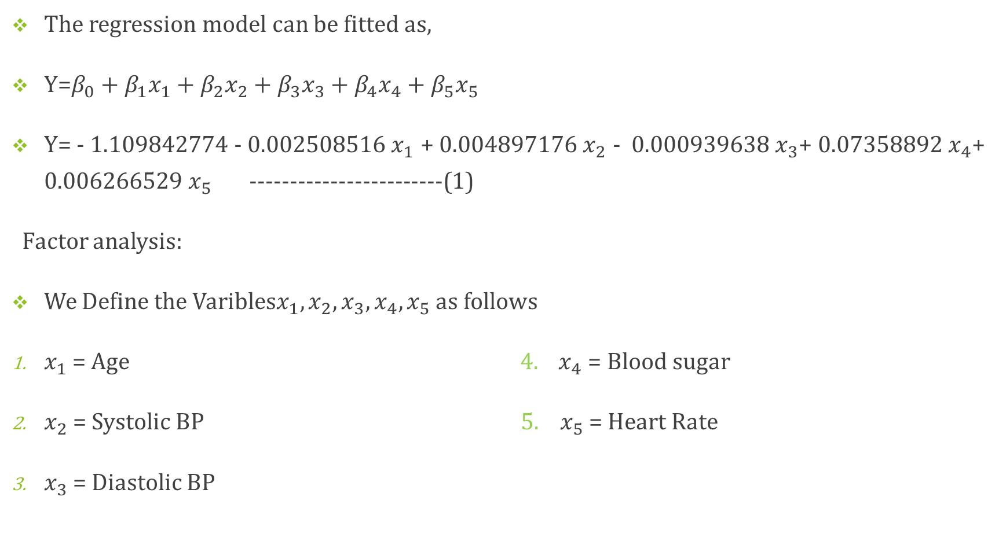
The regression model can be fitted as,
Y=$β_{0}+β_{1}x_{1}+β_{2}x_{2}+β_{3}x_{3}+β_{4}x_{4}+β_{5}x_{5}$
Y= - 1.109842774 - 0.002508516${ x}_{1}$ + 0.004897176$x_{2}$ - 0.000939638$x_{3}$+ 0.07358892${ x}_{4}$+ 0.006266529 $x_{5}$ ------------------------(1)
Factor analysis:
We Define the Varibles$x_{1},x_{2},x_{3},x_{4},x_{5}$ as follows
$x_{1}$= Age ${ 4. x}_{4}$= Blood sugar
$x_{2}$= Systolic BP 5. $x_{5}$ = Heart Rate
$x_{3}$ = Diastolic BP

Slide 21
Hence if the p-value is less than 0.01 then it is statistically significant and indicates strong evidence for the alternative hypothesis.
That means we will reject the null hypothesis if p-value is Less than 0.01

Slide 22
Residual plot

Slide 24
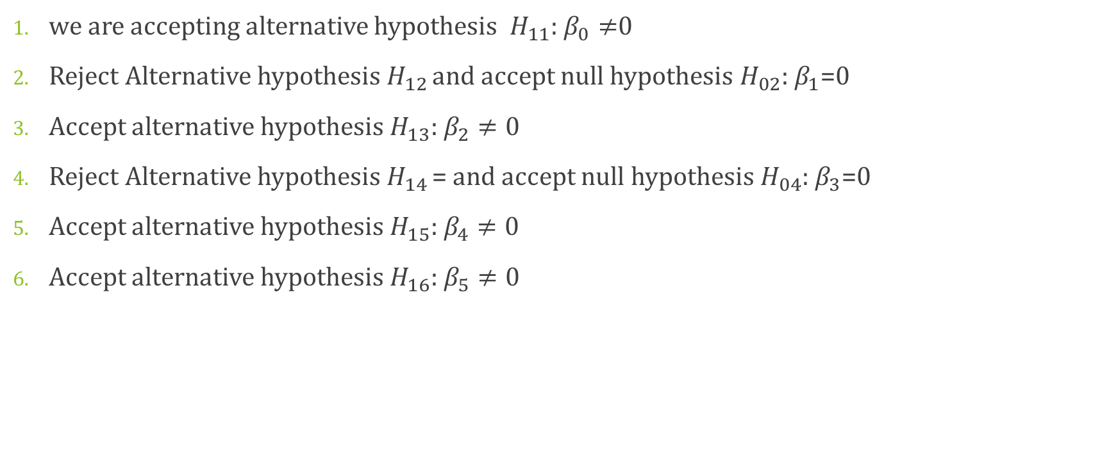
we are accepting alternative hypothesis $H_{11}$: $β_{0}≠$0
Reject Alternative hypothesis $H_{12 }$and accept null hypothesis $H_{02}$: $β_{1}$=0
Accept alternative hypothesis $H_{13}$: $β_{2}≠0$
Reject Alternative hypothesis $H_{14 }$= and accept null hypothesis $H_{04}$: $β_{3}$=0
Accept alternative hypothesis $H_{15}$: $β_{4}≠0$
Accept alternative hypothesis $H_{16}$: $β_{5}≠0$

Slide 25
Descriptive Statistics Descriptive statistics are used to describe the basic feature of data in study. They provides simple summaries about the sample and the measures.

Slide 26
Analysis of data using different charts and graphs
Fig : 1bar graph on risk and number of women
Fig : 2Line graph on frequency and risk

Slide 27
Fig : 6 bar graph on heartrate and risk

Slide 28
Fig : 5 100% stacked column chart on risk at different age

Slide 29
The correlation between all the variables from the given data is consider and their correlation is given in the following table:
CORRELATION TABLE:
Column1 | Age | SystolicBP | DiastolicBP | BS | BodyTemp | HeartRate | numerical repre
Age | 1 | 0.375931451 | 0.34784575 | 0.376616341 | -0.188843093 | 0.077407345 | 0.18301029
SystolicBP | 0.375931451 | 1 | 0.790002073 | 0.347533956 | -0.207266781 | -0.006088033 | 0.327365225
DiastolicBP | 0.34784575 | 0.790002073 | 1 | 0.300422859 | -0.201991561 | -0.016469927 | 0.254239452
BS | 0.376616341 | 0.347533956 | 0.300422859 | 1 | -0.042511479 | 0.135605419 | 0.548887618
BodyTemp | -0.188843093 | -0.207266781 | -0.201991561 | -0.042511479 | 1 | 0.087262428 | 0.25970076
HeartRate | 0.077407345 | -0.006088033 | -0.016469927 | 0.135605419 | 0.087262428 | 1 | 0.183289255
numerical repre | 0.18301029 | 0.327365225 | 0.254239452 | 0.548887618 | 0.25970076 | 0.183289255 | 1

Slide 30
Age is very less correlated with the Systolic BP, Diastolic BP, and blood sugar. and it is negatively less correlated with Body temperature and near to negligible correlated with heart rate.
Similarly have Systolic BP strongly correlated with. Diastolic BP.
Blood sugar is moderately correlated with the risk level.
Body temperature, heart rate, and risk are very less correlated with all the variables.

Slide 31
Analysis using Principle component analysis PCA, analysis the correlation or relationship between a variables. In this we try to determine a smaller number of variables that can explain this correlation. In this we have 6 variables. In this analysis we will come across one or two components that do a good job of explaining all this correlation. one of the key points of PCA is it’s a data reduction technique. Factor Analysis
Communalities
 | Initial | Extraction
Age | 1.000 | .469
Systolic BP | 1.000 | .763
Diastolic BP | 1.000 | .733
BS | 1.000 | .539
HeartRate | 1.000 | .643
BodyTemp | 1.000 | .384
Extraction Method: Principal Component Analysis.

Slide 32
Total Variance Explain
Total variance explains by matrix and scree plot are the factor extraction method. These
two commonly use processors for deciding how many components or factors to retain in
our solutions.
Component |  | Initial Eigenvalues |  |  | Extraction Sums of Squared Loadings
 |  | Total | % of Variance | Cumulative % | Total | % of Variance | Cumulative %
dimension0 | 1 | 2.383 | 39.709 | 39.709 | 2.383 | 39.709 | 39.709
 | 2 | 1.149 | 19.149 | 58.858 | 1.149 | 19.149 | 58.858
 | 3 | .882 | 14.704 | 73.562
 | 4 | .784 | 13.061 | 86.622
 | 5 | .594 | 9.908 | 96.531
 | 6 | .208 | 3.469 | 100.000
Extraction Method: Principal Component Analysis.

Slide 33
Scree plot
Screen plot graphs, the eigenvalue against each factor. We can see from the graph that after factor 2 there is a sharp change in curvature of screen plot. This shows that after factor 2 the total variance accounts for smaller and smaller amounts.
Component Score Coefficient Matrix
Component
1 | 2
.278 | .154
.363 | -.108
.353 | -.136
.251 | .372
.025 | .696
-.150 | .441
Extraction Method: Principal Component Analysis.

Slide 34
Component Matrix : The component matrix indicates the correlation of each variable with each factor.
Component Matrix
 | Component
 | 1 | 2
Age | .662 | .177
SystolicBP | .865 | -.124
DiastolicBP | .842 | -.156
BS | .597 | .427
HeartRate | .059 | .800
BodyTemp | -.358 | .506
Extraction Method: Principal Component Analysis.
a. 2 components extracted.
Component Score Covariance Matrix
Component |  | 1 | 2
dimension0 | 1 | 1.000 | .000
 | 2 | .000 | 1.000
Extraction Method: Principal Component Analysis.

Slide 35
PREDACTIVE ANALYSIS MODEL & CONCLUSION
CONCLUSION
As we have total 7 variables out of this we take one variable as a dependent variable and the other 5 variables are independent.
The dependent variable is Health Risk and the independent are Age, Systolic BP, Diastolic BP, Blood sugar and Heart Rate.
As we check the correlation we analysis that all the variables are moderately correlated with each other except systolic BP and Diastolic BP they are strongly correlated.
As we run the linear regression model in MS-Excel ,we get that 4 coefficients out of 6 are highly significant.
As their values are < 0.01.

Slide 36
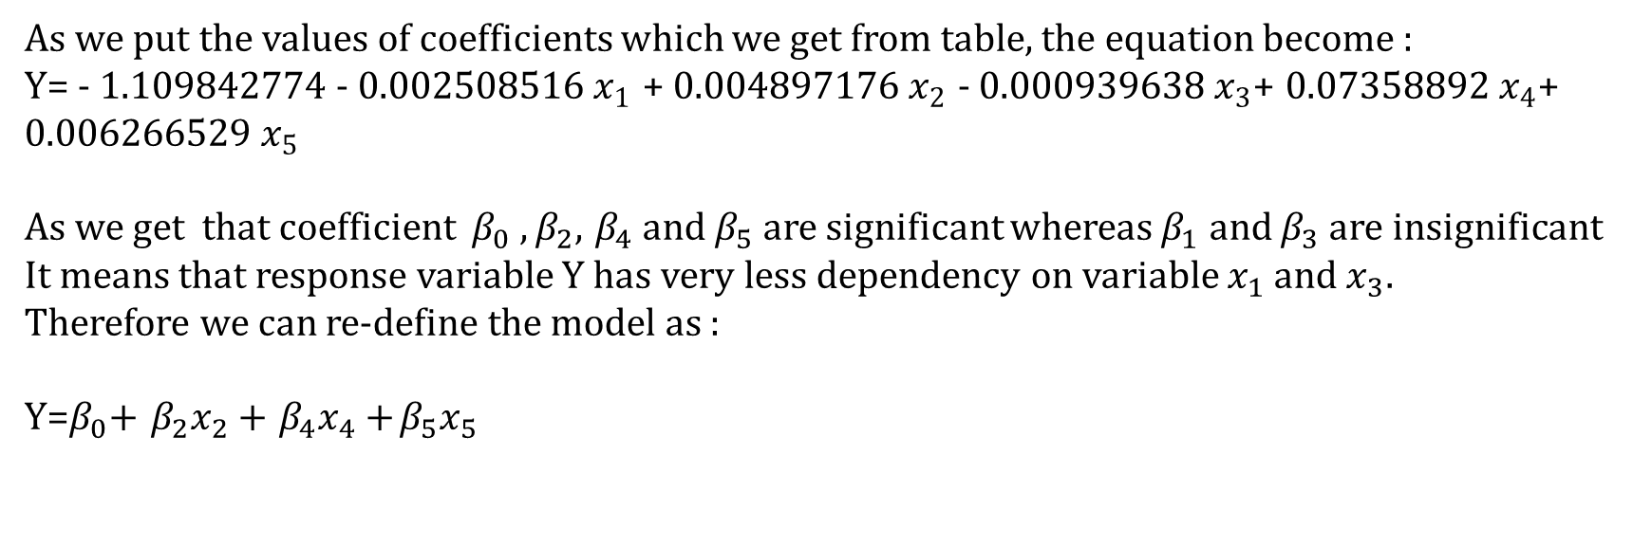
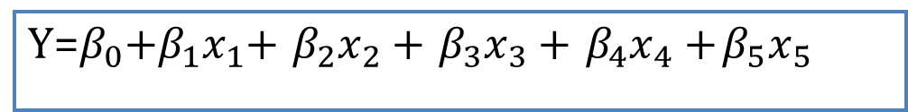
As all the assumption of regression is satisfied by our data hence we can set a model
on it. So, from the equation of the linear regression model, we can predict the maternal
risk of women. For all the 6 variables we set a model as follows:
Y=$β_{0}$+$β_{1}x_{1}$+$β_{2}x_{2}$+$β_{3}x_{3}$+$β_{4}x_{4}$+$β_{5}x_{5 }$
As we put the values of coefficients which we get from table, the equation become :
Y= - 1.109842774 - 0.002508516${ x}_{1}$ + 0.004897176$x_{2}$ - 0.000939638$x_{3}$+ 0.07358892${ x}_{4}$+ 0.006266529 $x_{5}$
As we get that coefficient $β_{0} ,β_{2}$,$β_{4}$and $β_{5}$are significant whereas $β_{1}$ and $β_{3}$are insignificant
It means that response variable Y has very less dependency on variable $x_{1}$ and $x_{3}.$
Therefore we can re-define the model as :
Y=$β_{0}$+$β_{2}x_{2}$+$β_{4}x_{4}$+$β_{5}x_{5 }$

Slide 37
The PCA analysis the correlation between variables. In PCA we try to reduce the dimensionality of variables or factors. For this, we determine the smallest number of variables that can explain the correlation.
In PCA from scree plot we Analysis that 2 components PCA1 and PCA2 are highly significant components. It means that 2 components are highly effective on dependent variable Y.
These 2 components are those which have a large variance than the other 4 variables.

Slide 38
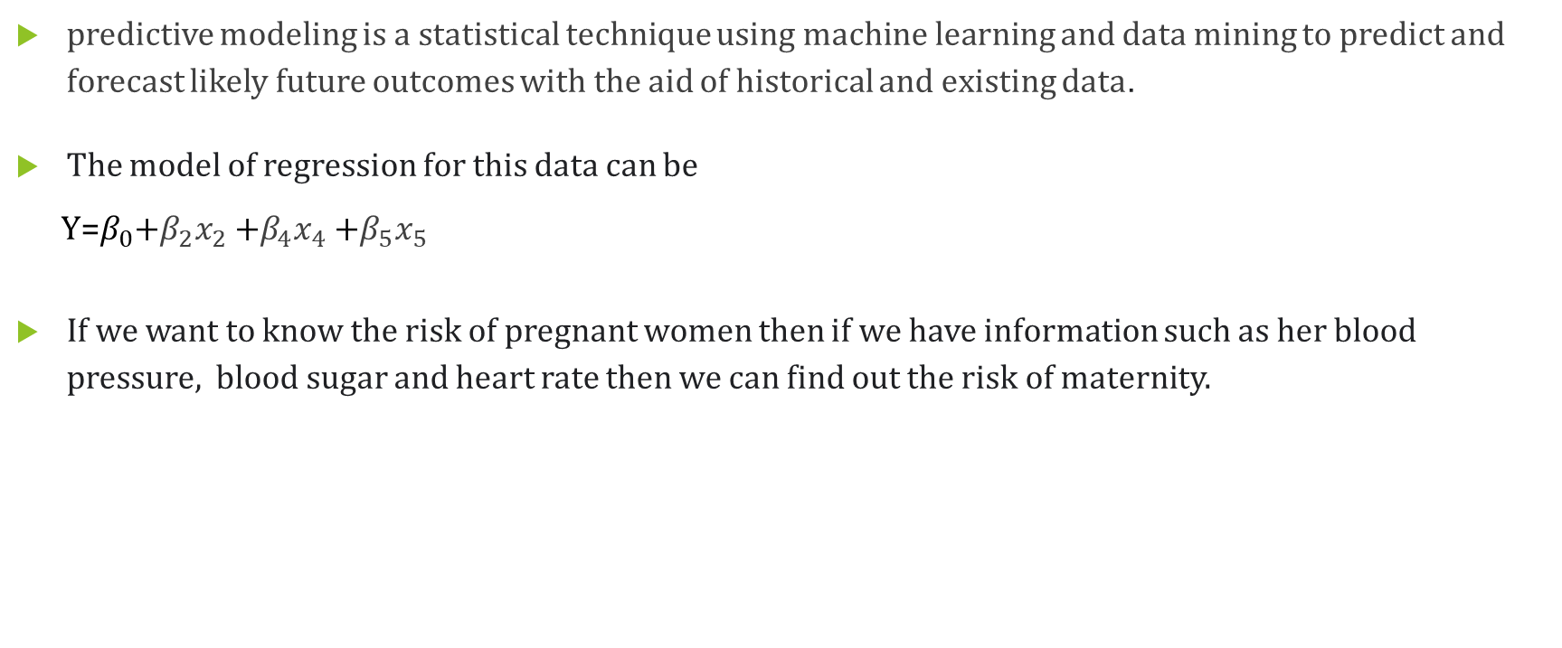
Prediction model :
predictive modeling is a statistical technique using machine learning and data mining to predict and forecast likely future outcomes with the aid of historical and existing data.
The model of regression for this data can be
Y=$β_{0}$+$β_{2}x_{2}$+$β_{4}x_{4}$+$β_{5}x_{5 }$
If we want to know the risk of pregnant women then if we have information such as her blood pressure, blood sugar and heart rate then we can find out the risk of maternity.

Slide 39
This model is very useful for medical care units and clinics where doctor have to decide which type of delivery process to applied on patient it will be decided on the basis of womens maternal health condition and risk level.
This model will tell the maternal health situation, if we get Y=0 then it will show low risk an safe maternal health.
If Y=0.5 the risk will be mid and safety measures should have to take .
If Y=1 or greater than 1 then the risk level is high and immediatly medical treatment will required.

Slide 40
References
The Journal of Obstetrics and Gynecology of India (March–April 2015) 65(2):93–96 DOI 10.1007/s13224-014-06
Ministry of Health and Family Welfare , Maternal Mortality Rate (MMR) Posted On: 12 FEB 5:36PM by PIB Delhicompressed.pdf
https://www.copenhagenconsensus.com/sites/default/files/booklet_on_maternal_and_newborn_health_-_copenhagen_consensus-compressed.pdf
https://www.kaggle.com/datasets
https://en.wikipedia.org/wiki/Maternal_health
https://www.slideshare.net/gurkiranjot/maternal-and-child-health-68463631
booklet_on_maternal_and_newborn_health_-_copenhagen_consensus-compressed

Slide 41
THANK YOU!

